Slide 1
Library Management System
Group 1
Members:
Tai Phong Lu - 614616
Ngoc Lam Anh Nguyen - 614638
Thi Hong Yen Truong - 614745

Slide 2
LMS – User cases
Requirement
#1. Login: Authorization levels are LIBRARIAN, ADMIN, and BOTH
#2. Add a new library member
#3. Checkout a book
#4. Add a copy of an existing book
Optional requirement
#1. Add a book
#2. Print the checkout record of a member

Slide 3
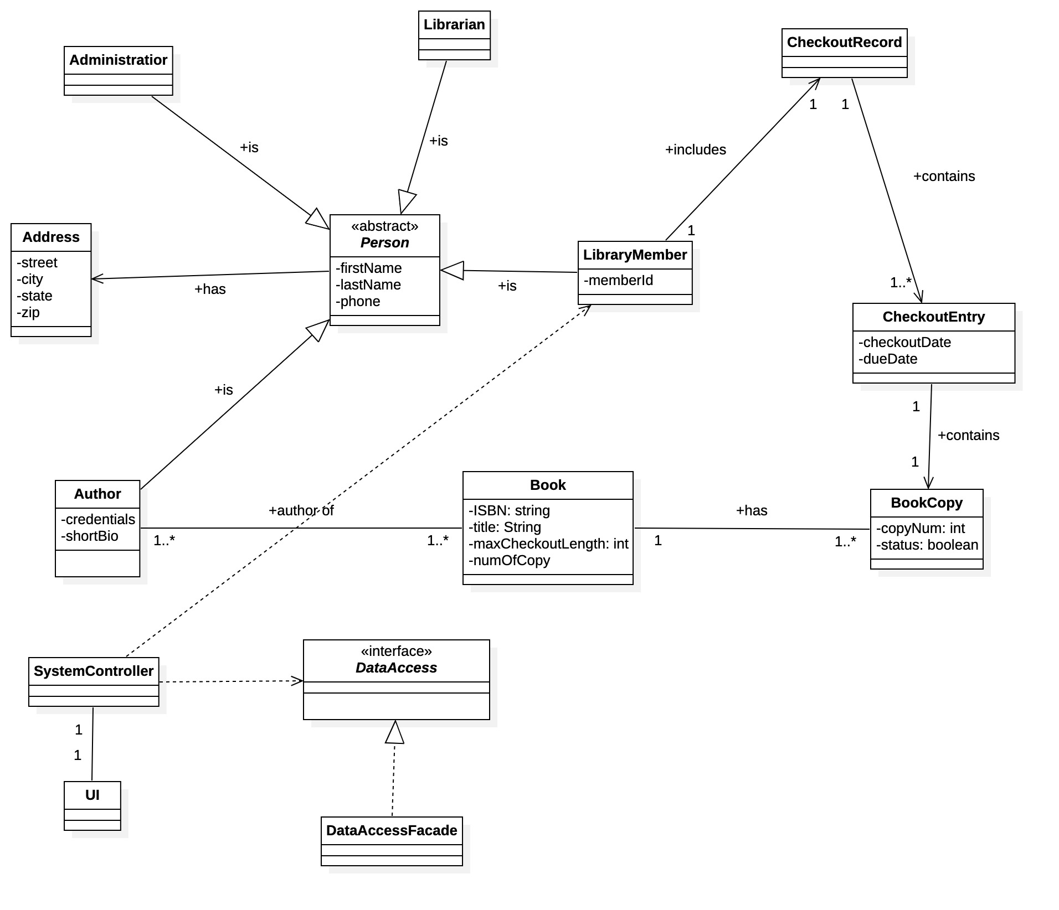
LMS – Class diagram

Slide 4
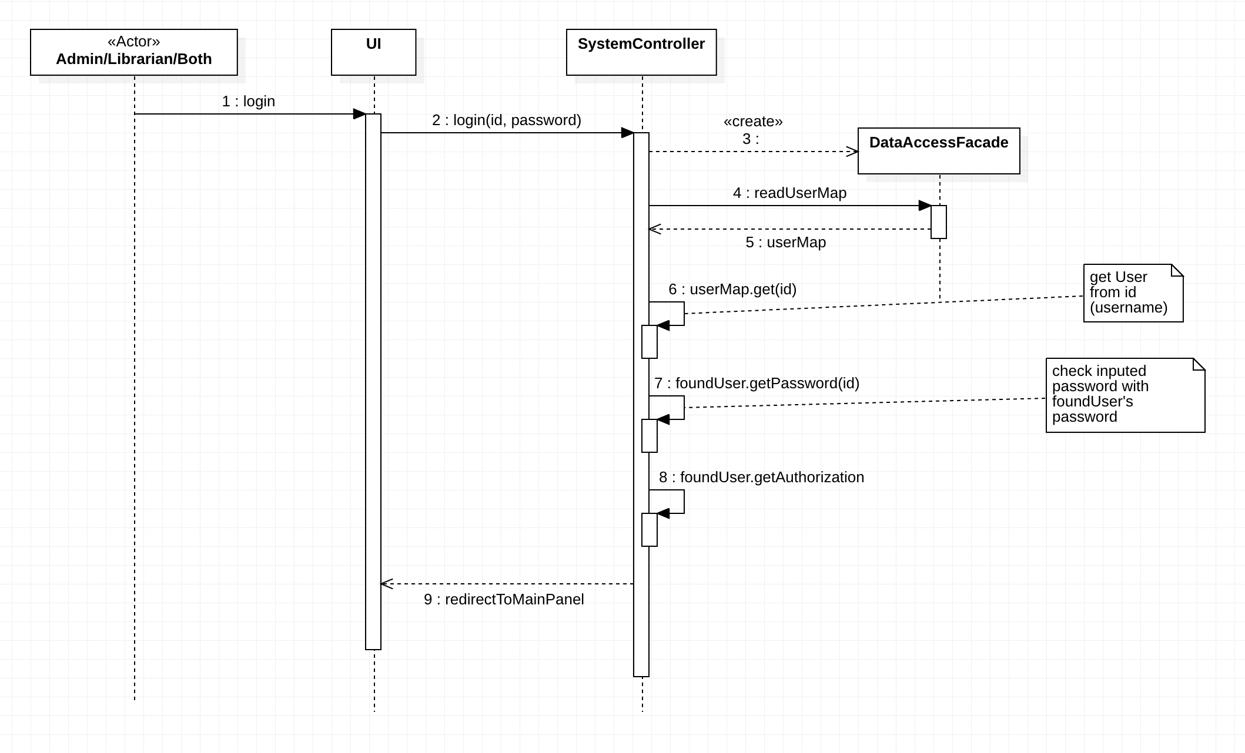
LMS – #1. Login

Slide 5
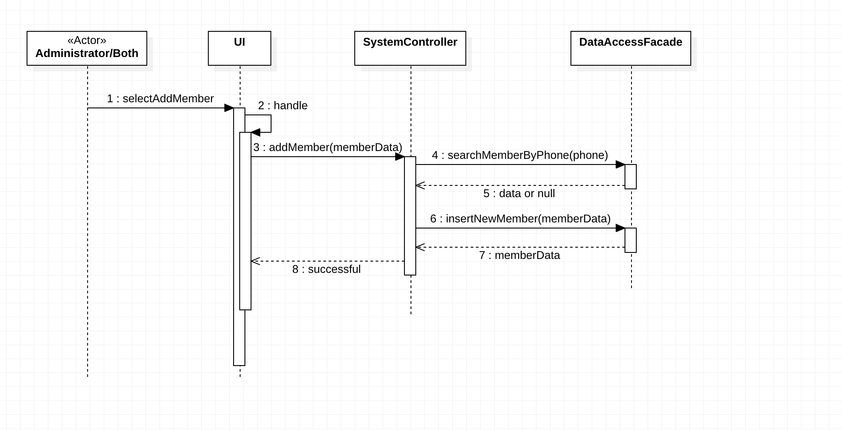
LMS – #2. Add New Library Member

Slide 6
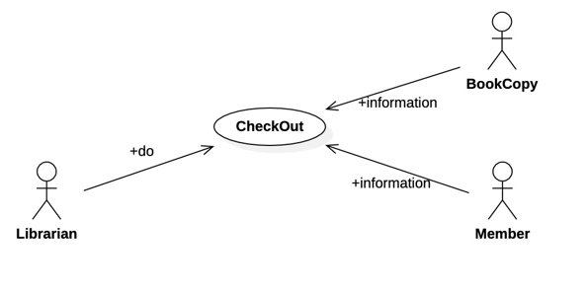
LMS – Check out

Slide 7
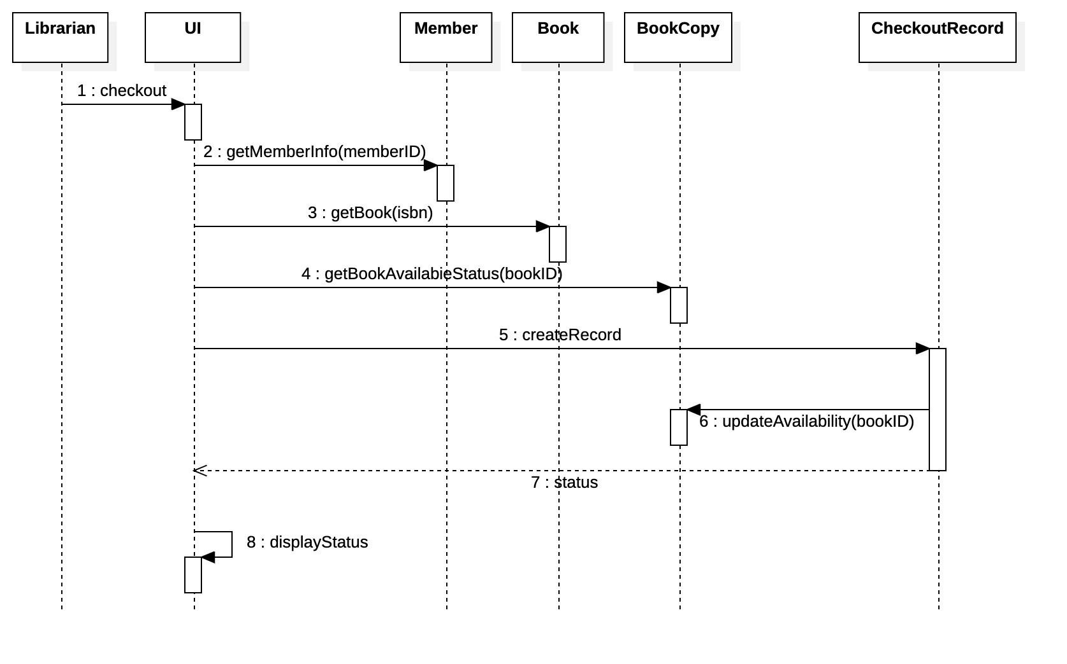
LMS – #3. Check out

Slide 8
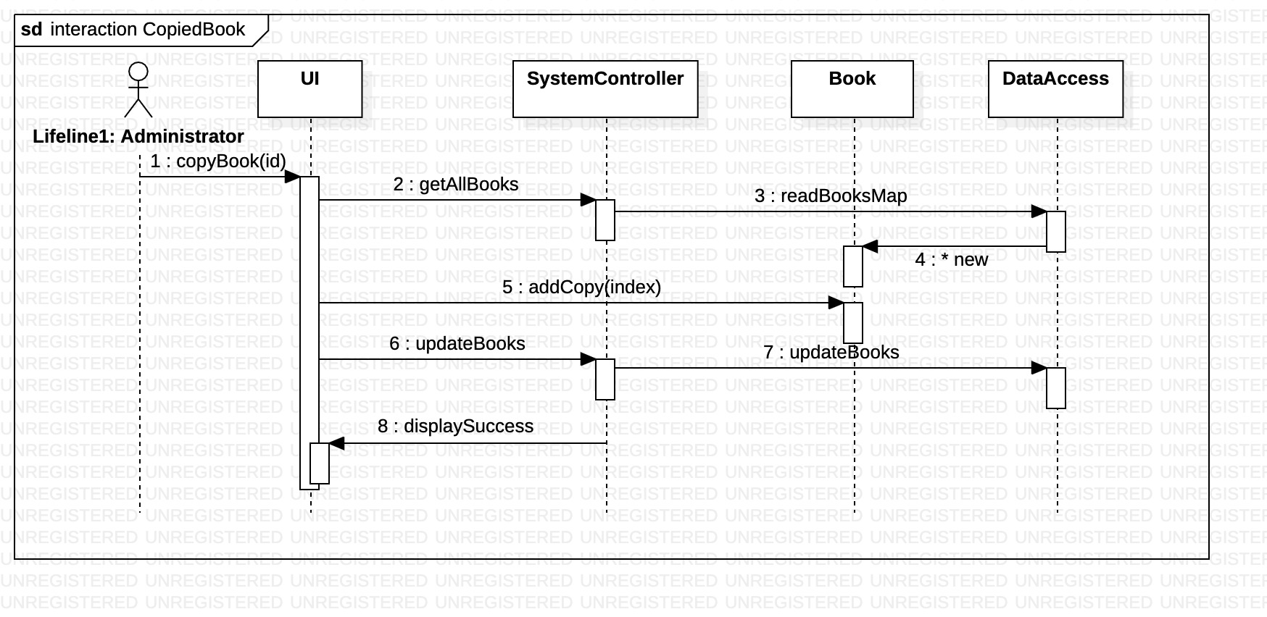
LMS – #4. Add a copy of an existing book

Slide 9
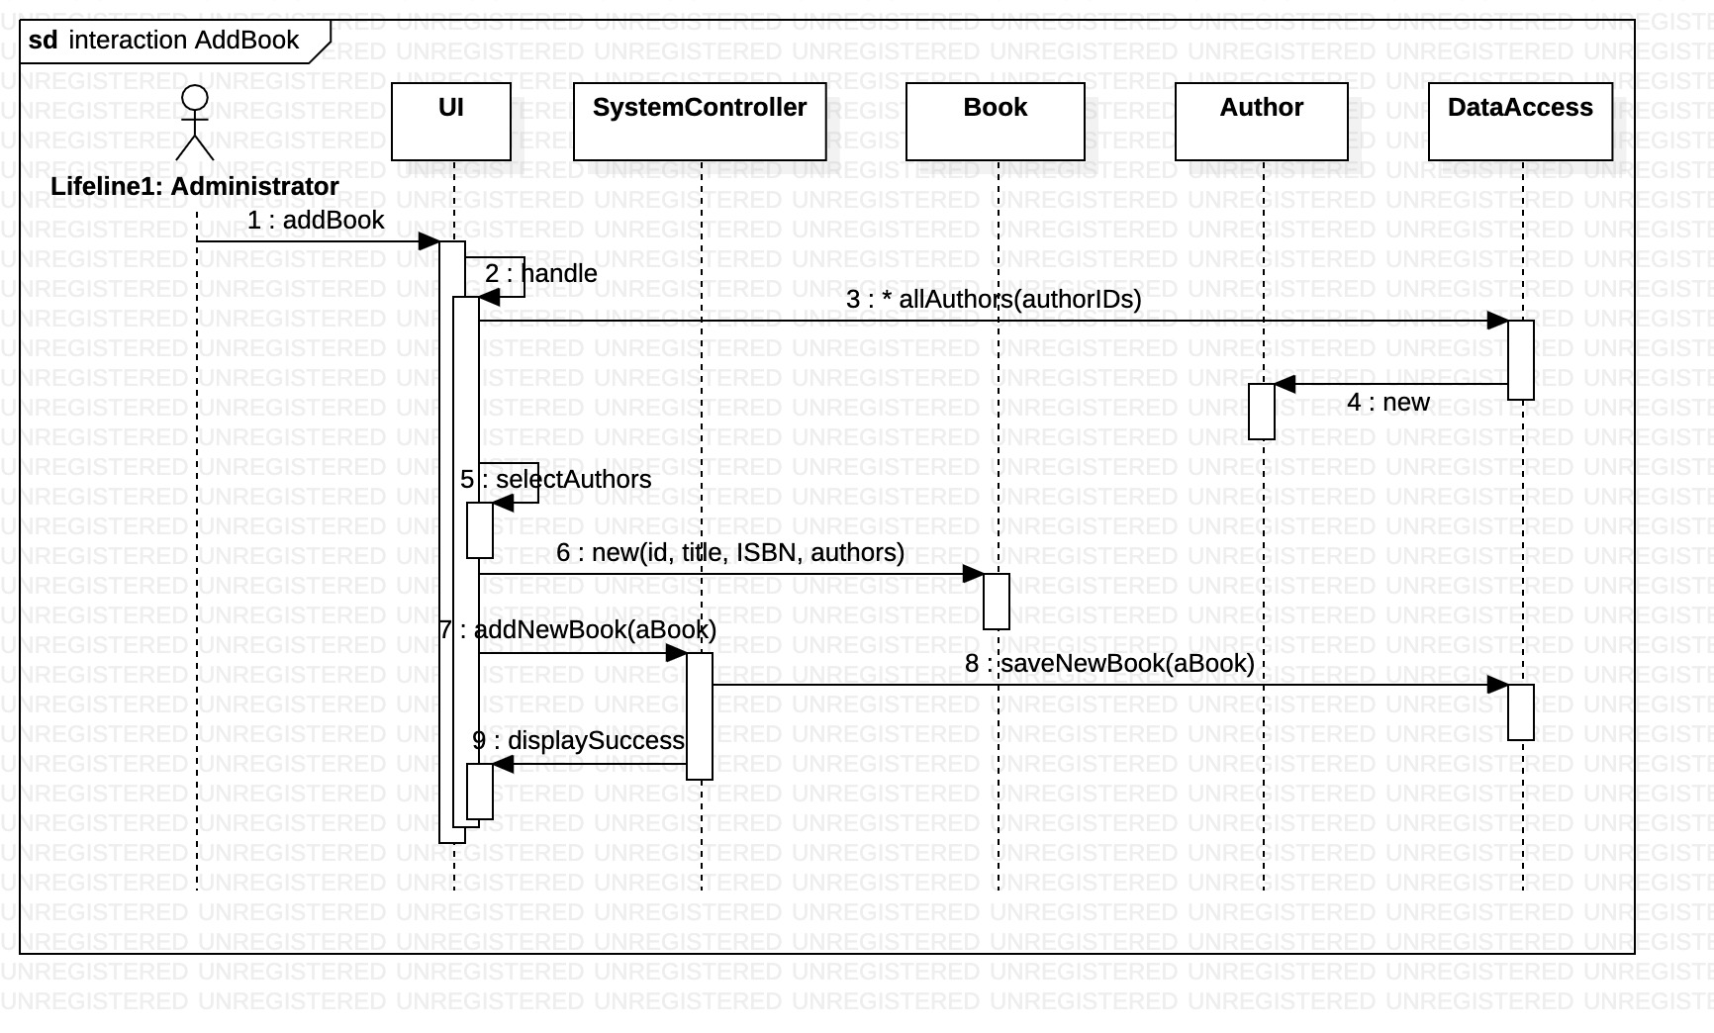
LMS – Opt#1. Add a book

Slide 10
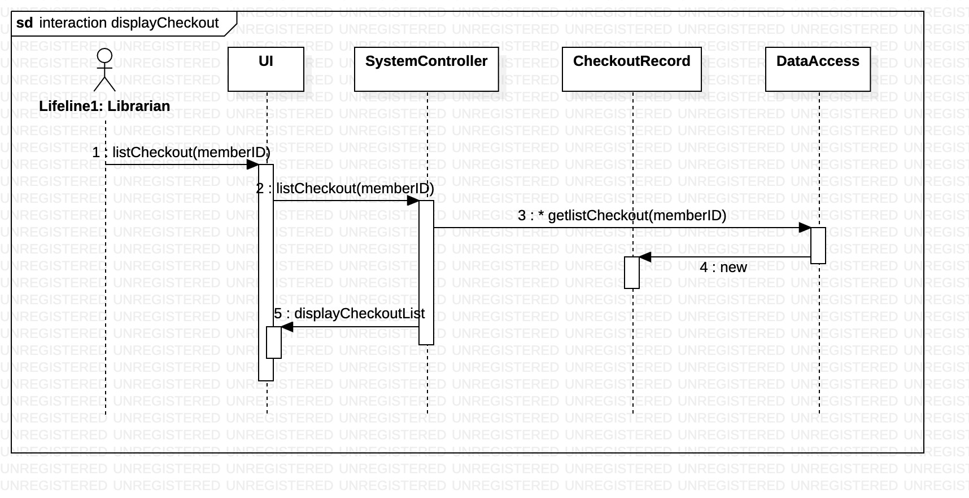
LMS – Opt#2. List checkout

Slide 11
LMS – MVP
Authentication.
Authorization (by restrict menu).
List, add, remove books.
List members.
Checkout (by book) with max date length per book.

Slide 12
LMS – On going
Checkout (by book copy), checking for availability, reduce the actual book copy.
Overdue list of checked out by member, by book isbn.

Slide 13
LMS
THANK YOU

